Slide 1

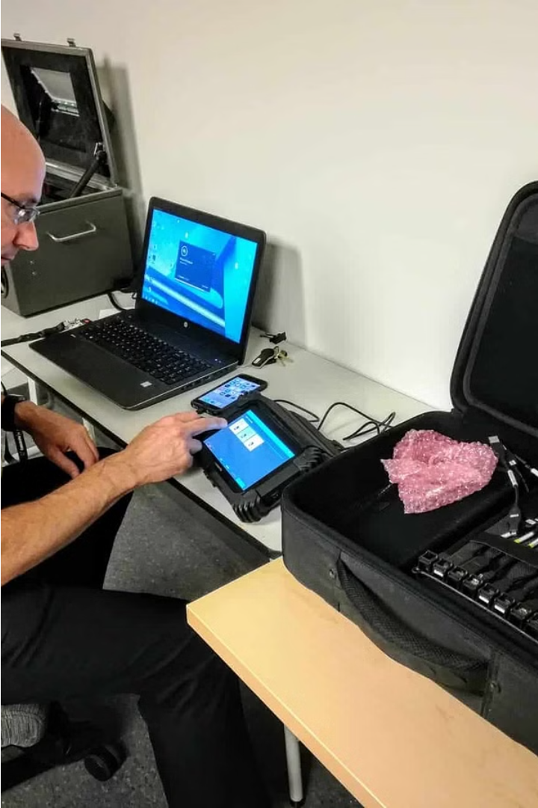

Introduction to Mobile Device Forensics
Explore the fascinating world of mobile device forensics, where expert investigators uncover digital evidence from smartphones, tablets, and other portable devices. Learn how to analyze data, recover deleted files, and leverage cutting-edge tools to solve crimes and protect privacy.

Slide 2
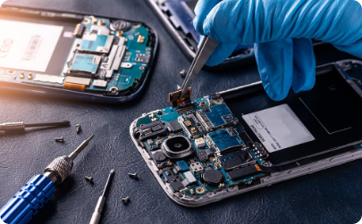
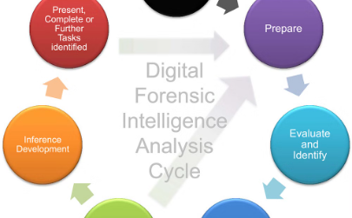
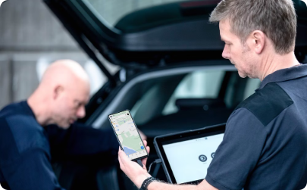
Importance of Mobile Forensics in Investigations
Critical Evidence
Evolving Landscape
Lawful Investigations
Mobile devices often contain vital evidence that can make or break a criminal investigation, from call logs and text messages to photos and browsing history.
As mobile technology continues to advance, mobile forensics has become an increasingly crucial field, requiring specialized tools and techniques to uncover relevant data.
Law enforcement relies on mobile forensics to conduct lawful investigations and gather admissible evidence, ensuring the integrity of the judicial process.

Slide 3




Types of Mobile Devices and their Forensic Considerations
Smartphones
Tablets
Wearables
Feature Phones
Smartphones, including iOS and Android devices, are the most common mobile devices encountered in forensic investigations.
Tablets, such as iPads and Android-based tablets, present unique forensic challenges due to their larger storage capacity and advanced features.
Smartwatches, fitness trackers, and other wearable devices can provide valuable evidence, but often require specialized extraction techniques.
Legacy feature phones, while less common today, may still be encountered and require specialized tools and techniques for data extraction.

Slide 4




Acquisition and Preservation of Mobile Device Evidence
Secure the Device
1
Isolate and disable the device to prevent data loss or tampering
2
Forensic Imaging
Create a complete, bit-for-bit copy of the device's storage
Chain of Custody
3
Meticulously document every step to ensure evidence integrity
Specialized Tools
4
Use forensic hardware and software to extract and analyze data
Properly acquiring and preserving mobile device evidence is crucial for successful investigations. This involves isolating the device, creating a complete forensic image, maintaining a detailed chain of custody, and utilizing specialized forensic tools and techniques to extract and analyze the data in a forensically sound manner.

Slide 5
Logical and Physical Extraction Techniques
1
Logical Extraction
2
Physical Extraction
This non-invasive approach extracts data from a mobile device's logical storage, such as contacts, messages, and app data, without altering the original device.
A more comprehensive technique that creates a bit-for-bit copy of the entire storage, including deleted and hidden data, for thorough forensic analysis.
3
Data Carving
4
Hardware-Assisted Extraction
Specialized tools can recover remnants of deleted files and artifacts, providing valuable evidence even from devices that have been wiped or damaged.
Advanced forensic tools can bypass security locks and extract data directly from the device's memory chips, crucial for locked or encrypted devices.

Slide 6
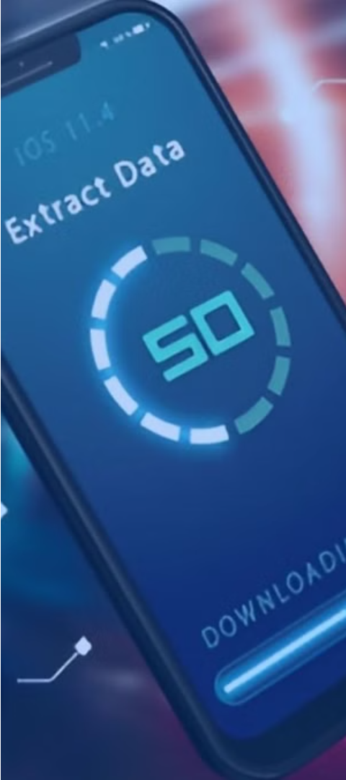
Data Analysis and Interpretation
1
Data Extraction
Utilize forensic tools to extract data from mobile devices, including contacts, messages, call logs, browsing history, and app activity.
2
Correlation and Link Analysis
Identify connections between data points to uncover relationships, timelines, and patterns that can provide key insights for investigations.
3
Contextual Understanding
Interpret the extracted data within the appropriate legal, technical, and investigative context to draw meaningful conclusions about the case.

Slide 7
Challenges in Mobile Forensics
Device Diversity
Data Encryption
Volatile Data
Limited Storage
The ever-evolving landscape of mobile devices, from smartphones to tablets, each with unique hardware and software configurations, poses a significant challenge in mobile forensics.
Strong encryption methods employed by mobile operating systems can hinder the extraction and analysis of data, requiring specialized techniques and tools to overcome these barriers.
Mobile devices often contain valuable volatile data, such as RAM contents and running processes, which can be lost if not properly preserved during the investigation process.
The limited storage capacity of mobile devices can make it challenging to acquire and preserve large volumes of data, requiring careful planning and efficient extraction methods.

Slide 8

Mobile Forensic Tools and Techniques
Mobile forensic professionals utilize a variety of specialized tools and techniques to acquire, analyze, and extract data from mobile devices. These include hardware and software solutions designed to overcome challenges posed by device encryption, data fragmentation, and proprietary file formats.
Techniques like chip-off, JTAG, and micro-USB connections enable physical data extraction, while logical acquisition methods leverage device protocols and data backup mechanisms. Powerful software tools automate the retrieval, decryption, and interpretation of critical evidence.

Slide 9
Reporting and Presentation of Findings
Clear and Organized
Attention to Detail
Professional Presentation
The forensic report should be structured logically, with sections for methodology, findings, and conclusions. Visuals like timelines and data visualizations can enhance clarity.
Ensure the report is thorough, documenting each step of the forensic process and providing comprehensive analysis of the evidence uncovered.
The final report should be polished and presented in a way that is suitable for legal proceedings or further investigation. Consider the audience and their needs.

Slide 10
Ethical and Legal Considerations in Mobile Forensics
Privacy and Consent
Chain of Custody
Respect individuals' privacy and ensure proper consent is obtained before accessing and analyzing mobile device data.
Maintain a robust chain of custody to preserve the integrity and admissibility of digital evidence in legal proceedings.
Jurisdictional Boundaries
Reporting and Testimony
Understand and comply with applicable laws and regulations governing mobile forensics across different jurisdictions.
Present findings objectively and transparently, ensuring reports and expert testimony adhere to legal and professional standards.

